Slide 1
NAME:R.AMARAN
REG NO:122201502
DEPARTMENT:B.COM(C.S)
COLLEGE:PACHAIYAPPA’S COLLEGE
Notes:
NAME : R. AMARAN
REG NO :122201502
DEPARTMENT:B.COM(C.S)
COLLEGE:PACHAIYAPPA’S COLLEGE

Slide 2


Employee Performance Analysis: Leveraging Excel for Data-Driven Insights
Harnessing the power of Excel, we'll explore how to analyze employee performance, uncover actionable insights, and empower informed decision-making.
by Shabir L

Slide 3

Introduction to Employee Performance Analysis
Employee performance analysis is a systematic process of evaluating individual and team performance, identifying strengths and weaknesses, and suggesting strategies for improvement.
1
Objective
2
Benefits
To measure and understand employee performance for better decision-making.
Improved employee engagement, productivity, and overall organizational success.
3
Tools
4
Applications
Data collection, analysis, and visualization tools like Excel are essential.
Performance reviews, talent management, and strategic planning.

Slide 4
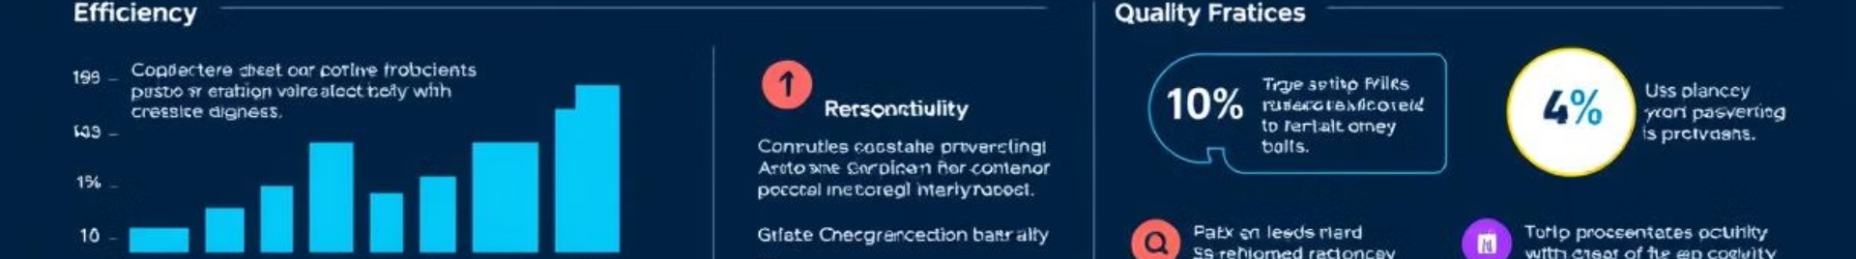
Key Metrics for Measuring Employee Performance
Measuring employee performance requires selecting the right metrics that align with business objectives and individual roles.
Metric
Description
Productivity
Output per unit of time, such as sales, units produced, or tasks completed.
Efficiency
Effectiveness in using resources, like time, materials, and budget.
Quality
Accuracy, completeness, and adherence to standards in work output.
Customer Satisfaction
Feedback and ratings from customers regarding service and product quality.
Goal Achievement
Progress made toward individual and team goals set for a specific period.
Attendance and Punctuality
Regularity and timeliness in work attendance.
Engagement
Employee motivation, enthusiasm, and commitment to work.

Slide 5

Collecting and Organizing Employee Data in Excel
Excel provides a powerful platform for collecting, storing, and organizing employee data for analysis.
Data Sources
Data Organization
Performance reviews, time tracking systems, customer feedback surveys, and employee surveys.
Creating a spreadsheet with appropriate columns for employee information, performance metrics, and relevant dates.
Data Cleaning
Data Validation
Ensuring data accuracy, removing duplicates, and handling missing values.
Using Excel's built-in features to ensure data integrity and consistency.

Slide 6
Visualizing Employee Performance Data with Excel Charts and Graphs
Excel offers a wide array of charts and graphs to visualize employee performance data and uncover patterns.
Line Chart
Bar Chart
Pie Chart
Tracking performance trends over time, showing growth, decline, or stability.
Comparing performance across different employees, teams, or periods.
Illustrating the proportion of performance metrics, such as strengths and weaknesses.

Slide 7
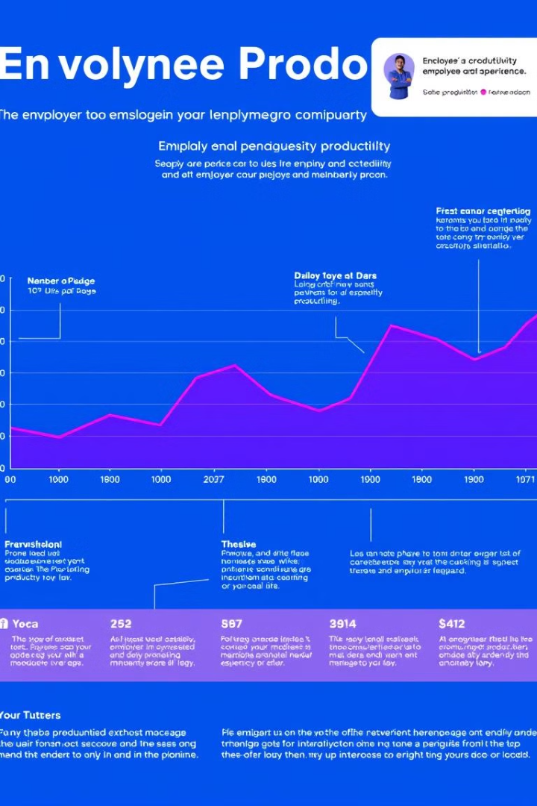




Identifying Trends and Patterns in Employee Performance
By analyzing visualized data, we can identify trends and patterns in employee performance over time.
Trend Analysis
Looking for upward or downward trends in productivity, efficiency, or quality over time.
Seasonal Variation
Identifying any cyclical patterns in performance related to specific time periods or events.
Outliers
Analyzing unusual performance spikes or dips to understand their underlying causes.
Correlations
Examining relationships between different performance metrics, such as productivity and training completion.

Slide 8
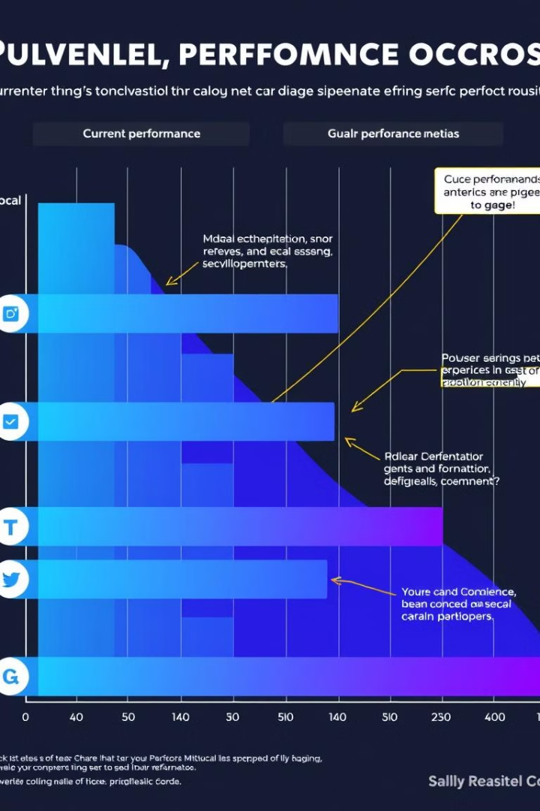




Analyzing Performance Gaps and Opportunities for Improvement
By identifying performance gaps, we can pinpoint areas where employees need additional support or training.
Goal Gaps
Skills Gaps
Analyzing the difference between actual performance and set goals to identify areas for improvement.
Identifying any deficiencies in skills or knowledge that hinder performance.
Feedback Gaps
Resource Gaps
Analyzing the frequency and effectiveness of feedback to employees for improvement.
Identifying any lack of necessary resources or tools that may be impacting performance.

Slide 9

Leveraging Insights to Enhance Employee Development and Productivity
Insights gained from performance analysis can be used to develop targeted strategies for employee growth and improvement.
1
Individualized Development Plans
Creating customized training and development programs based on individual performance gaps.
2
Mentorship and Coaching
Providing guidance and support to employees to help them overcome challenges and develop skills.
3
Performance Feedback
Providing regular and constructive feedback to employees on their strengths and areas for improvement.
4
Performance Incentives
Motivating employees with rewards and recognition for achieving goals and exceeding expectations.

Slide 10

Conclusion: Empowering Data-Driven Decision Making
Employee performance analysis using Excel empowers organizations to make informed decisions and drive positive outcomes.
Informed Decision Making
Improved Performance
Using data-driven insights to make strategic decisions about talent management and workforce development.
Enhancing employee performance and productivity through targeted development and support.
Enhanced Engagement
Organizational Success
Boosting employee morale and engagement by recognizing achievements and providing opportunities for growth.
Contributing to overall organizational success by optimizing workforce performance and maximizing return on investment.

Slide 11

Thank you
Thank you for your time and consideration. We look forward to discussing how we can help you leverage Excel for employee performance analysis.

